Slide 1
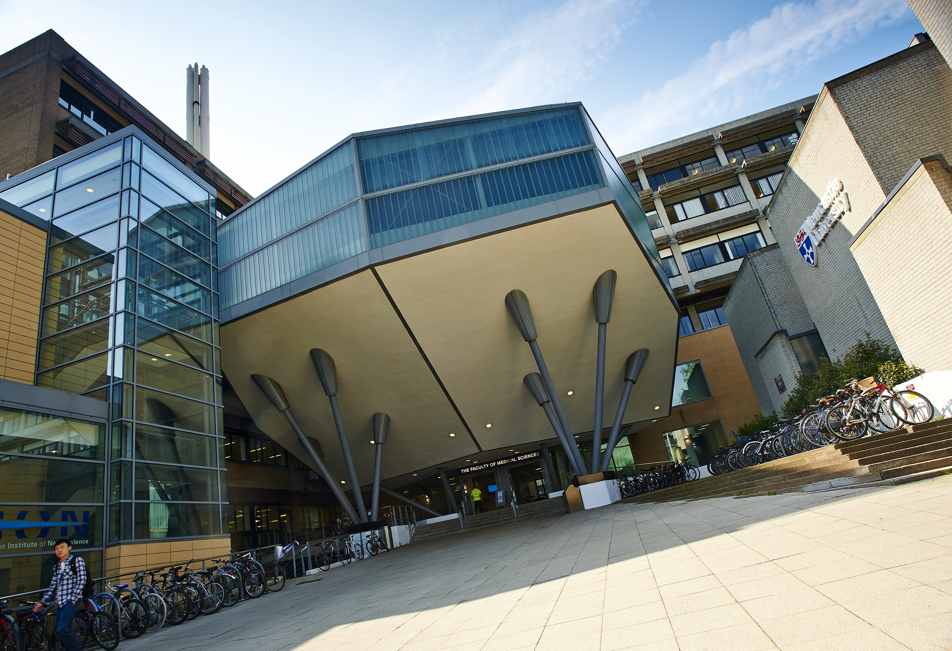




Thinking Big: Our Faculty approach to EDI
Prof Candy Rowe
Faculty of Medical Sciences (FMS)

Slide 2
My role and the EDI Team in the Faculty
Director of Equality, Diversity and Inclusion: To be the strategic lead for EDI in the Faculty, and develop and implement policies, initiatives and cultural change in support of equality, diversity and inclusion

Slide 3
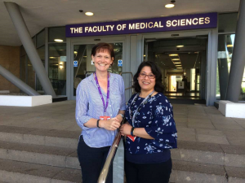
My role and the EDI Team in the Faculty
Director of Equality, Diversity and Inclusion: To be the strategic lead for EDI in the Faculty, and develop and implement policies, initiatives and cultural change in support of equality, diversity and inclusion
EDI Officer: Ann Armstrong
Athena SWAN Officer:
Malasree Home

Slide 4


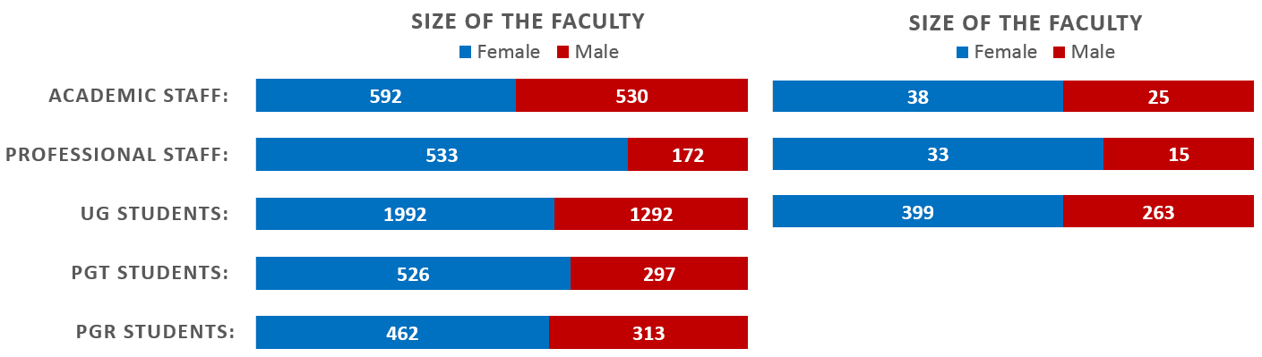
Overview of our Faculty
We’re large and have a global footprint
Nearly 2000 staff and over 5500 students

Slide 5
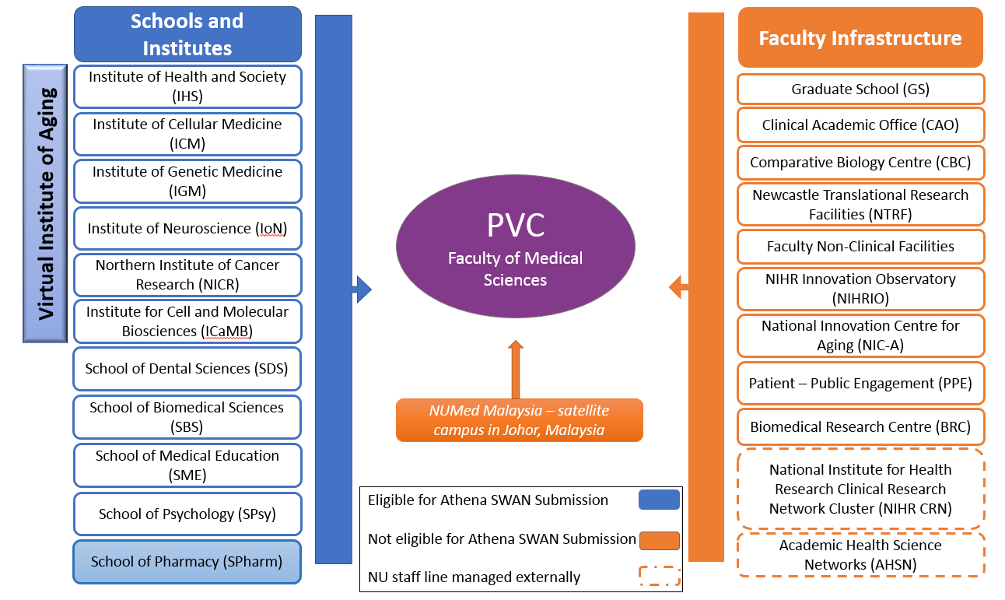
Overview of our Faculty

Slide 6


Athena SWAN Awards in FMS
Institute of Health & Society (IHS)
SILVER 2011, 2014
Institute of Cellular Medicine (ICM)
SILVER 2013, 2016
Institute of Genetic Medicine (IGM)
BRONZE 2014, SILVER 2015
Institute of Neuroscience (IoN)
SILVER 2015
Northern Institute for Cancer Research (NICR)
SILVER 2015
School of Biomedical Sciences (BMS)
BRONZE 2015
School of Medical Education (SME)
BRONZE 2015
School of Dental Sciences (SDS)
BRONZE 2015
Institute of Cell and Molecular Biosciences (ICaMB)
BRONZE 2015

Slide 7
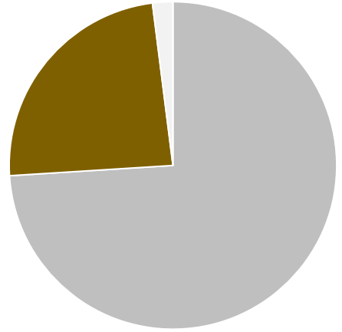


Athena SWAN Awards in FMS
24%
74%

Slide 8
Five benefits to working on EDI at a Faculty level

Slide 9
1
We can develop a more cohesive and ambitious Faculty-wide EDI vision and strategy

Slide 10
EDI Strategy Group with Faculty oversight
Co-chaired: Director of EDI & Faculty PVC
EDI Vision and Strategy 2018-2023
Involving senior management, staff and students
Increase visible leadership
Set pace and direction
Increase engagement

Slide 11
2
We can tackle bigger issues that lie outside the immediate control of individual units with more resource

Slide 12

Parenting & Childcare Review 2017
£15K, 600 staff/students surveyed, 3-year funded action plan (2018-21)
Academic Returners’ Programme
£70K p.a., flexible scheme to support carers returning after a period of extended leave
Use resources more effectively
Reduce duplication of effort
Achieve Faculty-wide change
Notes:
Deal with those more thorny issues that also tend to need more resourcing

Slide 13
3
We can better embed EDI across Faculty business

Slide 14
Annual EDI Review of student data
Established an annual review with our Faculty Learning and Teaching Committee
EDI in Role Descriptors
Currently exploring where we can embed responsibility for EDI in key roles
Commit to principles of 30% Club
All our committees have at least 30% women
Embed EDI in to the work of different committees and leadership roles
Establish a shared responsibility for EDI

Slide 15
4
Pooling data helps us identify issues and give new perspectives

Slide 16
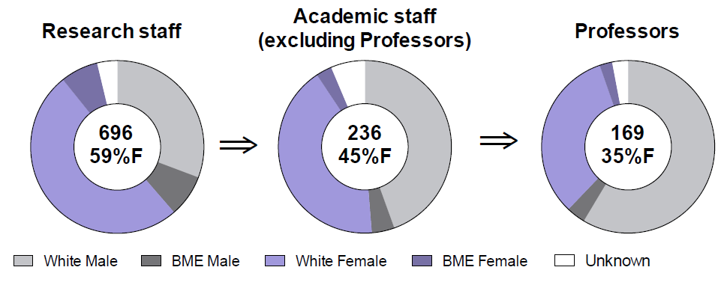
Intersection of gender and race
12% of female research staff are BME
=> 7% of academic female staff are BME
We can look at intersectionality for the first time
Patterns emerge that were previously hidden

Slide 17

Increasing proportion of female professors
2012/13
2016/17
F
M
F
M
45
129
59
110
26% Female
35% Female
42% Professorial hires were women
43% Promotions to Chair were women
We can look at intersectionality for the first time
Patterns emerge that were previously hidden

Slide 18
5
Free-up time from making multiple (often overlapping) Athena SWAN applications to work as a team

Slide 19
Harmonising data capture methods
E.g. Exit questionnaires, Culture surveys
Improving inductions
Including embedding EDI for all staff & students
Workload allocation model
Work together to design and test a new model
Increase the sharing of good practice
Staff can lead on Faculty-wide initiatives
Increase the pace of change

Slide 20
“We don’t know enough about what the Faculty is doing to advance equality, diversity and inclusion.”
“Isn’t Athena SWAN application just box ticking?”

Slide 21


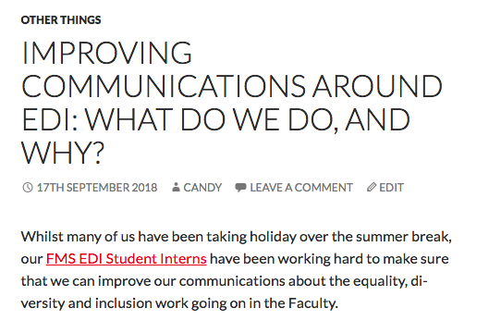
“We don’t know enough about what the Faculty is doing to advance equality, diversity and inclusion.”
“Isn’t Athena SWAN application just box ticking?”

Slide 22
What are our main challenges?
Embracing a culture that values strength through diversity
Communication and engagement
Harmonising and embedding policies and good practice
Developing a broader EDI agenda

Slide 23

What do we do?
Find out more
Contact me or the team:
candy.rowe@ncl.ac.uk
FMS.Diversity@ncl.ac.uk
Check out our website and blog:
https://www.ncl.ac.uk/medicalsciences/about/equality-diversity
http://bit.ly/EDIblog
Follow us on twitter
@FMSDiversityNCL

